Slide 1
MCH Campus Hackathon 3&4 February 2018, Galgotias University Greater Noida Make for India

Slide 2
Team Arjuna
Team Members:
1. Manas Bhardwaj
2. Aayush Bajaj
3. Harshita Jain

Slide 3
Problem Statement
To Minimize Online Advertisement Costs and to reduce Online Advertisement Security Breaches particularly those based on the authentication of both sides of transaction

Slide 4
Vision:
Decentralized Advertisement System
The digital advertising ecosystem is built on trust, working at its best when all participants are good,when no one tries to deceive anyone else. Advertisers need assurance that their ads will be visible in the right places, and publishers want to be sure they aren’t losing revenue when fraudulent ads are sold in their name.
If fraudulent ads have a negative impact on site traffic, user experience, and monetization, then publishers will allocate to other channels that don’t risk their core business. It’s extremely important for the industry that marketers have the utmost confidence in the programmatic revolution of ad buying, and are not having to trade innovation and effectiveness for quality.

Slide 5
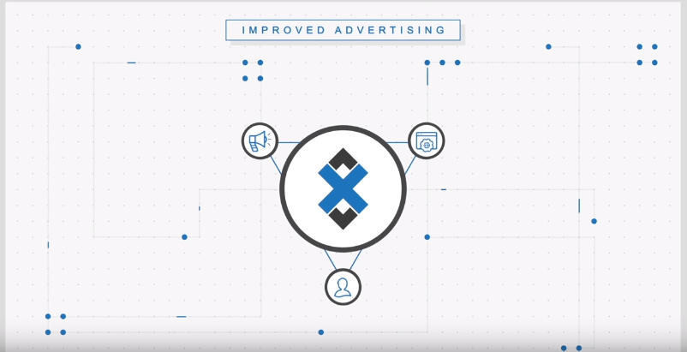
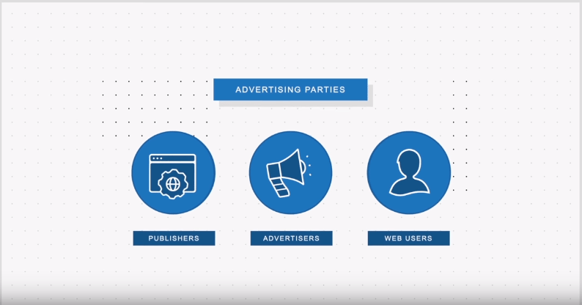
UI Details

Slide 6
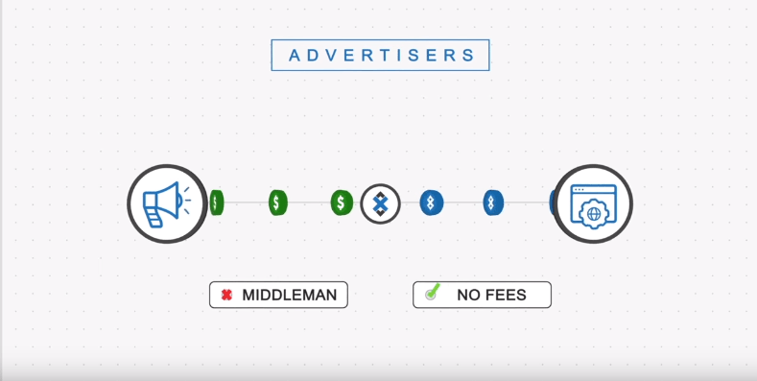
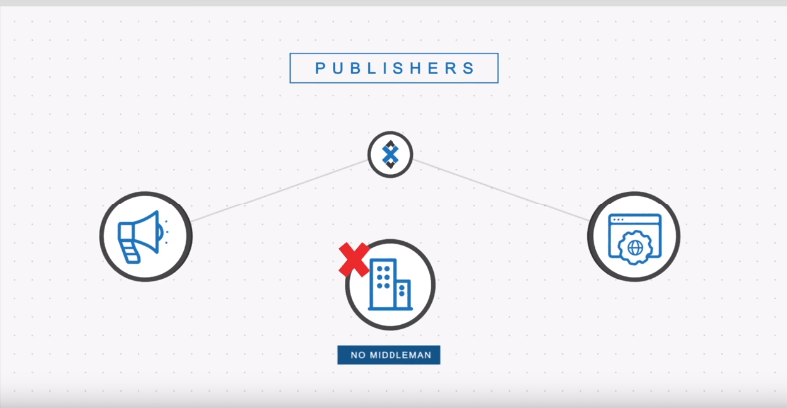

Slide 7
Technologies Used:
BLOCKCHAIN
Web 3.0
Ethereum Contracts
Python
Anaconda

Slide 8
Business Model
Our Idea will be a open-source project but to overcome deployment costs a nominal fee would be charged from publisher as well as advertiser
But it won’t go as high as Google Adwords/FB Ads ☺

Slide 9
Execution Plan
Publisher/Advertiser Signs up at AdZap
Advertiser list all the ads of its products
Publisher then chooses relevant ad from the list of probable selection and get paid accordingly in the form of tokens
Advertiser then publish the add as selected by the publisher
Both get awarded in the form of money and the strength of promotion
AdZap saved close to $65Billion of the advertiser money and money lost to security breaches

Slide 10
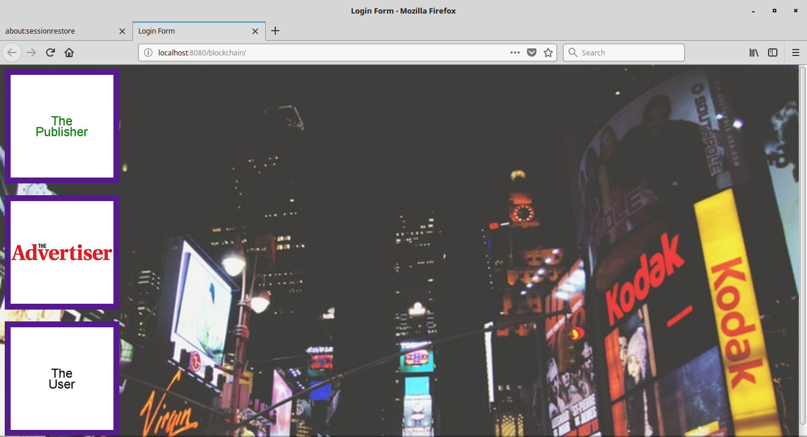

Slide 11
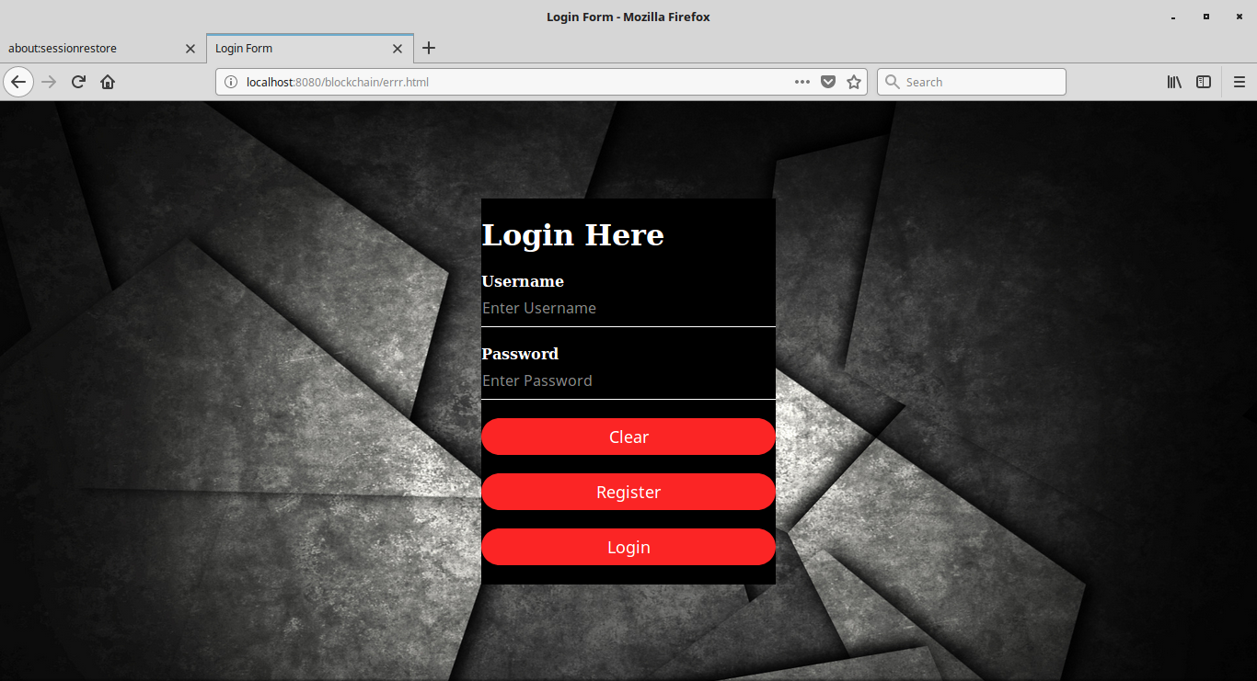

Slide 12
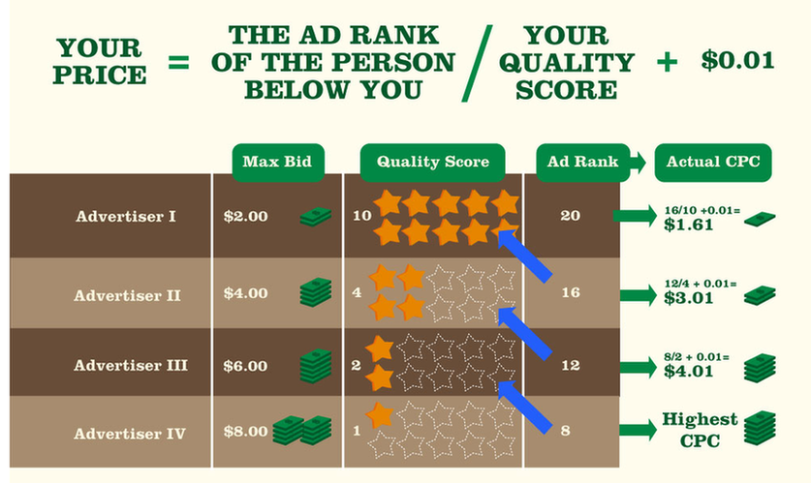

Slide 13
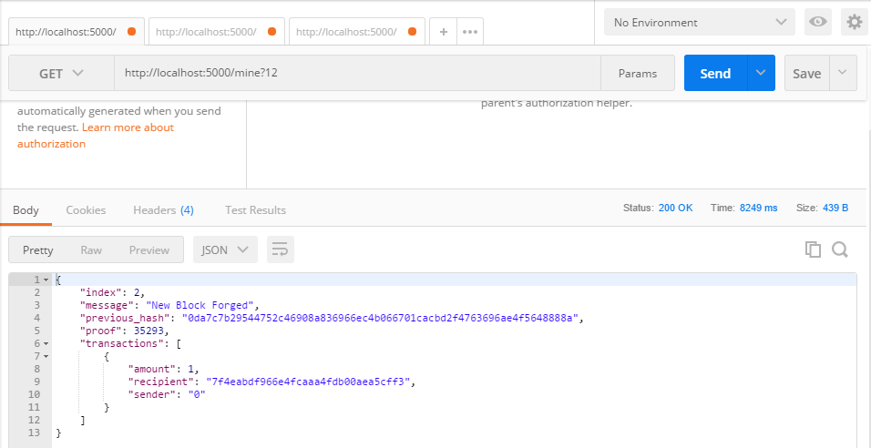

Slide 14
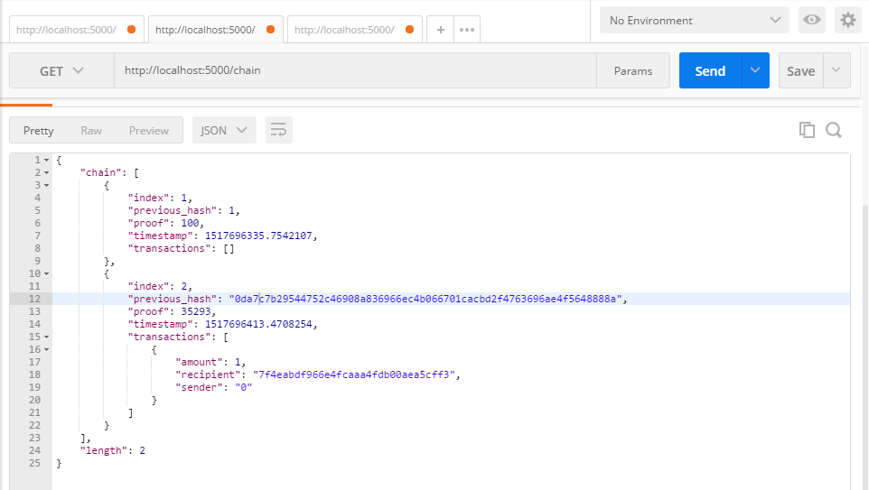

Slide 15
Plan and Timeline
Created a BlockChain network to support decentralized working of each connected node(Publisher/Advertiser)
Created a Decentralized Application using web3.0
Smart Contracts for authentic transfer of funds

